Slide 1

The European Association Medical devices
Notified Bodies
Presentation on Web Site
2021
Team-NB Web Presentation 2021

Slide 2






Context of TEAM-NB
COMMISSION : DG SANTE
EMA
MDCG
CEN
CENLEC
NBCG
NBO
Market
Surveillance
Expert groups
EUDAMED
IVD
VIGILANCE
M
R
A
Switzerland
Canada
Australia
New Zealand
USA
Japan
...
NBTG
CPME
CAMD
AESGP, COCIR, EAAR, EHIMA, EuPC, EUROM,
EUROM VI,
EUROMContact, FIDE,
MedTech Europe
Health
Professionals
Notified Bodies
Manufacturers
Authorised
Representatives
Notification
Accreditation
27 Competent
Authorities
National Accreditation
Bodies
I
M
D
R
F
TEAM-NB representatives
2
Team-NB Web Presentation 2021

Slide 3
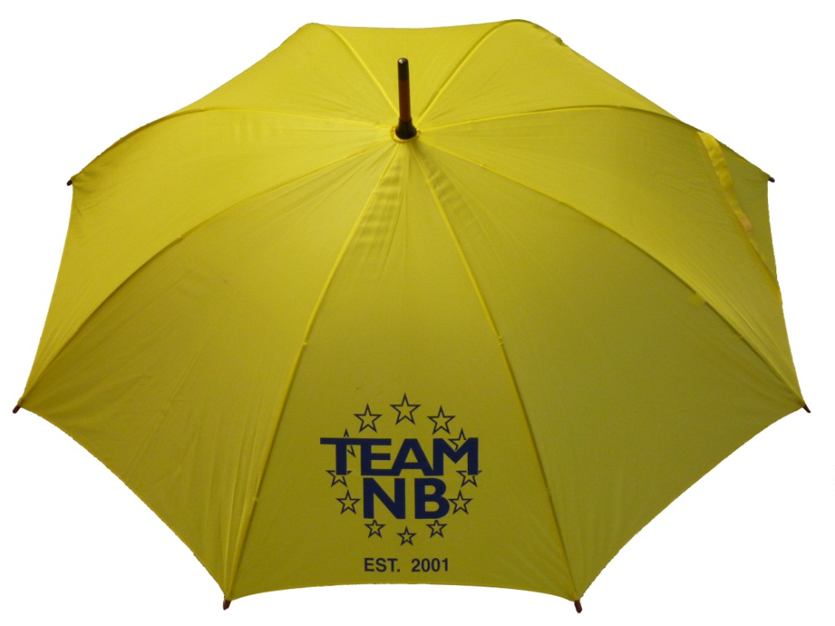
Team-NB
Aims:
  Represent Notified Bodies
  Communication with
    European Commission
    Competent Authorities
    Industry
  Promote technical and ethical standards
  Participate in improving the legal framework
  Contribute to harmonization (e.g. training ‘for notified bodies by
  notified bodies’)
Team-NB Web Presentation 2021

Slide 4
Team-NB
Members over the years
Team-NB Web Presentation 2021

Slide 5
Team-NB
MDR / IVDR designation: TEAM-NB Members versus Designated NBs
Team-NB Web Presentation 2021

Slide 6
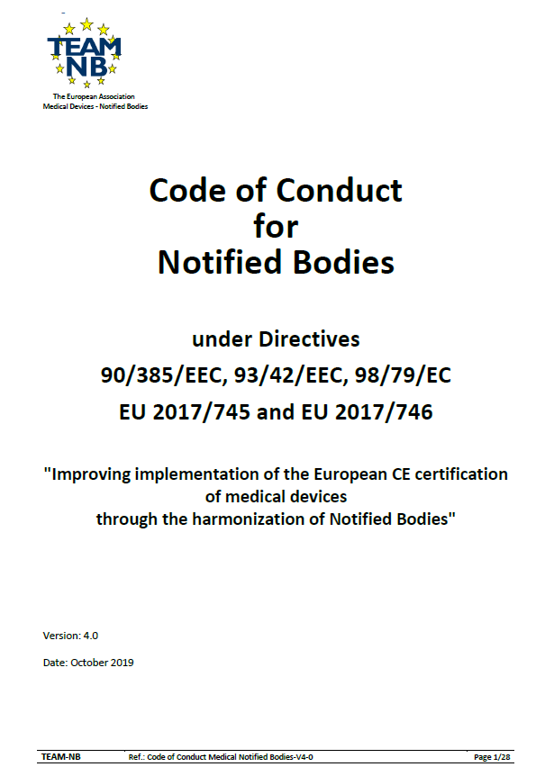
Code of Conduct Version 4
Mandatory to sign for TEAM-NB members
Version 4.0 approved on October 2019
Alignment with MDR / IVDR requirements
Available on website www.team-nb.org

Slide 7
Interpretation of the new regulations
  Team-NB established working groups already from April 2016
  Aim: formulate an analyse of the new regulations and propose to the members
    Procedures to be put in place
    To-do lists
    …
    to be done to submit application for designation and/or wait for implementing acts
      Help members to be designated
      Allow harmonisation
Classification & Conformity Assessment
NB requirements
Clinical
Vigilance
6
Team-NB Web Presentation 2021

Slide 8
Interpretation of the new regulations
Team-NB established working groups from 2016
  Aims
  Help members to be designated
  Allow harmonization
Team-NB Web Presentation 2021

Slide 9
Implementation of the new regulations
MDCG mirror WGs
  Aims
  to allow notified bodies members to speak of 1 voice
  to prepare and participate in the MDCG meetings
  to write reports
    distributed to all members
    to share information
  to comment on MDCG proposals
  to write Position Papers (published on Team-NB web site)
Team-NB Web Presentation 2021

Slide 10
Implementation of the new regulations
Task Forces
  Aims
  to address specific topics of NBs interest
    Article 117
    TCP III - Taiwan
    Transfer Agreement
    Standard fees publically available
    TOC (table of content)
  to write Position Papers (published on Team-NB web site)
to harmonise | views practises
Team-NB Web Presentation 2021

Slide 11

Implementation of the new regulations
Trainings
  Aims
  to help NBs to deal with new MDR / IVDR requirements in their assessment.
  to achieve a better harmonisation among NBs thanks to the exchanges
Team-NB Web Presentation 2021

Slide 12
Implementation of the new regulations
Trainings in 2019
  Clinical data: 3 sessions
Trainings in 2020
  Clinical data: 1 session
  Technical Documentation: 2 sessions in September + 1 Q4
  Risk Management: 2 sessions in December
Trainings in 2021
  Performance for in vitro diagnostics
  Software classification
Team-NB Web Presentation 2021

Slide 13
  Transition period
  CE mark after "Entry into Application"
    Compliance with MDD or AIMD
    No significant change in design and intended purpose
    Application of the requirements of the Regulations related to
    Post-market surveillance, Market surveillance, Vigilance, Registration of economic operators and devices,
    NB remains in charge of surveillance
  Contract between Manufacturers and NBs
    update to be signed to allow surveillance audits
13
Team-NB Web Presentation 2021

Slide 14
Regulation tools
  Commission tools
    Under the MDCG supervision
    Common specifications
        New instrument to be adopted by implementing acts which manufacturers will need to apply
    Delegated and implementing acts
        instrument to precise regulation articles
14
Team-NB Web Presentation 2021

Slide 15
European databank on MD (EUDAMED)
  Use of a medical device nomenclature mandatory
  Data to be uploaded to collate and process information regarding MD
  SRN – single registration number
  UDI – unique device identifier -> traceability
  aspects of conformity assessment
  notified bodies
  certificates
  clinical investigations
  vigilance and market surveillance
15
Team-NB Web Presentation 2021

Slide 16

Contacts
Management:
Alexey Shiryaev (Alexey.Shiryaev@dnvgl.com) – president
Guy Buijzen (guy.buijzen@dekra.com) – treasurer
Gero Viola (gero.viola@de.tuv.com) – secretary
Suzanne Halliday (Suzanne.Halliday@bsigroup.com) – vice president
Sabina Hoekstra-van den Bosch (Sabina.Hoekstra@tuv-sud.nl) – vice president
Françoise Schlemmer (schlemmer@team-nb.org) -Director and Secretariat
www.team-nb.org
16
Team-NB Web Presentation 2021

Slide 17
























Members
Team-NB Web Presentation 2021

