Slide 1

The European Association Medical devices
Notified Bodies
“VISION on REVISION”
1

Slide 2


TEAM-NB
Aims:
Communication with
  European Commission
  Competent Authorities
  Industry
Promote technical and ethical standards
Participate in improving the legal framework
Contribute to harmonization
Represent Notified Bodies
Team-NB-Presentation – Vision on Revision

Slide 3
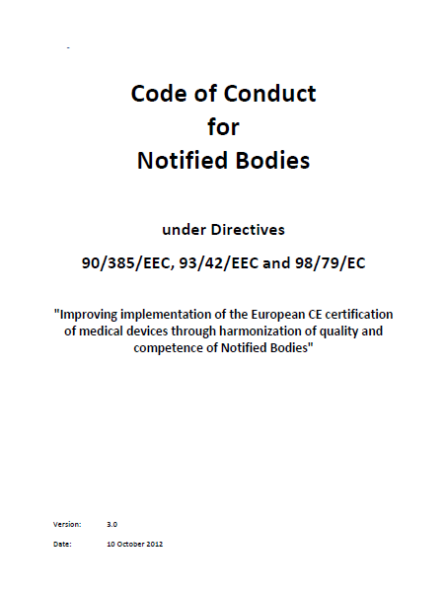
Raising the bar for Notified Bodies
Mandatory to sign for TEAM-NB members
Available on website
Changes and additions:
  Extension to IVD
  Unannounced visits
  Product Verification
  Supervisory Structure
  Peer assessment
Team-NB-Presentation – Vision on Revision

Slide 4
Detailed content CoC V3.1
Implementation, enforcement and monitoring of the Code of Conduct
  Auditor pool being contracted
  Inspections starting after summer when transition is over
  Annual self-evaluation on top
Unannounced visits
Qualification and Assignment of Notified Body Assessment Personnel
Minimum time for Notified Body assessments
Sampling of class IIa and IIb technical files
Design Dossier Reviews
Rules for subcontracting
Rules for Certification Decisions
Team-NB-Presentation – Vision on Revision

Slide 5
Statement towards ‘Daily Telegraph’
TEAM-NB members are committed to ensure the safety of Medical Devices on the EU market
TEAM-NB members abide by regulatory and ethical aspects by law as well as on voluntary basis
TEAM-NB members agree to be submitted to a strong and harmonized assessment and surveillance system by member states and commission
TEAM-NB members are fully aware of their responsibility to ensure certification of medical devices complies with the Directives
Team-NB-Presentation – Vision on Revision

Slide 6
PMA versus enhanced Notified Body system
Uniform strict requirement for notified bodies
Uniform supervision by joint authorities, coordination COM
Centralised and decentralised Market Approval no solution – will stifle innovation & promote consolidation
The years that European patients benefit from early entry of products on the market are too valuable for our healthcare system to just throw it away
Need to remove rotten apples from manufacturers, notified bodies as well as practitioners in unacceptable off label use and in not-reporting clinical problems with medical devices in the current system
Team-NB-Presentation – Vision on Revision

Slide 7
Single use - Reprocessing
supportive of adding control to a largely unregulated area
‘in-house’ reprocessing of single-use devices by health institutions same req.s as outsourced reprocessing
No national deviations: safety and performance of the reprocessed device are not a choice but a need
Reprocessable as basis adds too much risks to patients
A list of single-use devices for critical use which can be reprocessed, decided by the Commission with oversight from Member States, will secure a high level of patient safety. SCENIHR could advise updating such list.
Team-NB-Presentation – Vision on Revision

Slide 8
Scope & Reclassifications
Non-viable human material not substantially manipulated to be added (in line with USA)
Products that contain viable organisms not to be excluded; as most products contain some
Products that intentionally incorporate biological substances or organisms that are viable can be excluded
Reclassifications to class III mostly oke
Team-NB-Presentation – Vision on Revision

Slide 9
intended to be ingested, inhaled or administered rectally or vaginally .... absorbed by or dispersed in the human body
Inconsistencies in wording
  ‘implantable device’ means any device, including those that are partially or wholly absorbed, which is intended……
  Rule 6 All surgically invasive devices intended for transient use are in class IIa unless they:… – have a biological effect or are wholly or mainly absorbed in which case they are in class IIb,…
  Rule 7 All surgically invasive devices intended for short-term use are in class IIa unless they:… have a biological effect or are wholly or mainly absorbed in which case they are in class III,…
Inconsistency with special rule
  Would include IVF Media for embryo storage, administered vaginally and dispersed by the body. This contradicts the proposal in the MDR to classify such products as class IIb.
Inconsistency excluding some body orifices
  administered via the eye, ear or nose
Happy to keep IIa, IIb, III via rules 6-8 and special rules; borderline group can actively classify
Team-NB-Presentation – Vision on Revision

Slide 10
Traceability – Implant cards - Transparency
Supportive of improved traceability requirements
Supportive of introduction UDI
Supportive of (electronic) implant cards, also for partial implants
Supportive of good functioning accessible database
Supportive of summary evaluation report for products with periodic safety update reporting
Team-NB-Presentation – Vision on Revision

Slide 11
Clinical trials and evidence
Clarification of intent MemberState approving clin. trials
Supportive of coordination on multi-country trials
Clinical experts (relevant to the field) to be used for assessment of new and innovative high risk device - most of such clinicians will not be permanent staff, as the expertise is mostly available in practicing surgeons and professors.
At least four years of practice in clinical field relevant to device under review
Actively practicing surgery in field of application for min1 day a week, max 4 yrs ago
Practicing in IMDRF countries, or having practiced there for a minimum of 4 years
Demonstrated knowledge on reviewing, designing or conducting clinical trials
Declaration listing what the clinician reviewed before (review CV tracking)
Team-NB-Presentation – Vision on Revision

Slide 12
Some further topics
PMS/PMCF – support growing emphasis for notified bodies to review continuously - DIS ISO 13485:2014/15
MDCG to become an effective forum for decision-making
  Include notified bodies in working groups
‘cosmetic implants’ – either rule based or time-limited review of positive inclusion list – clinical benefit issues
CTS helpful on top of harmonised standards if all stakeholders can contribute – e.g. Specification minimum aspects for clinical trials for new types of implants
Team-NB-Presentation – Vision on Revision

Slide 13
Last slide on notified body qualifications
TEAM-NB members should arrange to be properly resourced with the necessary expertise
Members state designation authorities should meet the same requirements in order to supervise appropriately
TEAM-NB is of strong opinion that tightening up monitoring of notified bodies with assessments, audits and better communication is crucial to ensure a consistent level of scrutiny of manufacturers & devices across EU
Qualification requirements for personnel involved in conformity assessment procedures to be described in more detail to ensure level playing field all over Europe
Team-NB-Presentation – Vision on Revision

Slide 14

Contacts
Management:
Gert Bos (gert.bos@bsigroup.com) – president
Hans Heiner Junker (hans-heiner.junker@tuev-sued.de) – vice president
Guy Buijzen (guy.buijzen@dekra.com) – assistant vice-president
Aud Løken Eiklidh (Aud.Loken.Eiklid@presafe.com) - treasurer
Corinne Delorme (corinne.delorme@lne.fr) – secretary
Françoise Schlemmer (schlemmer@quasys.com) -Director and Secretariat
www.team-nb.org
Team-NB-Presentation – Vision on Revision

